Slide 1
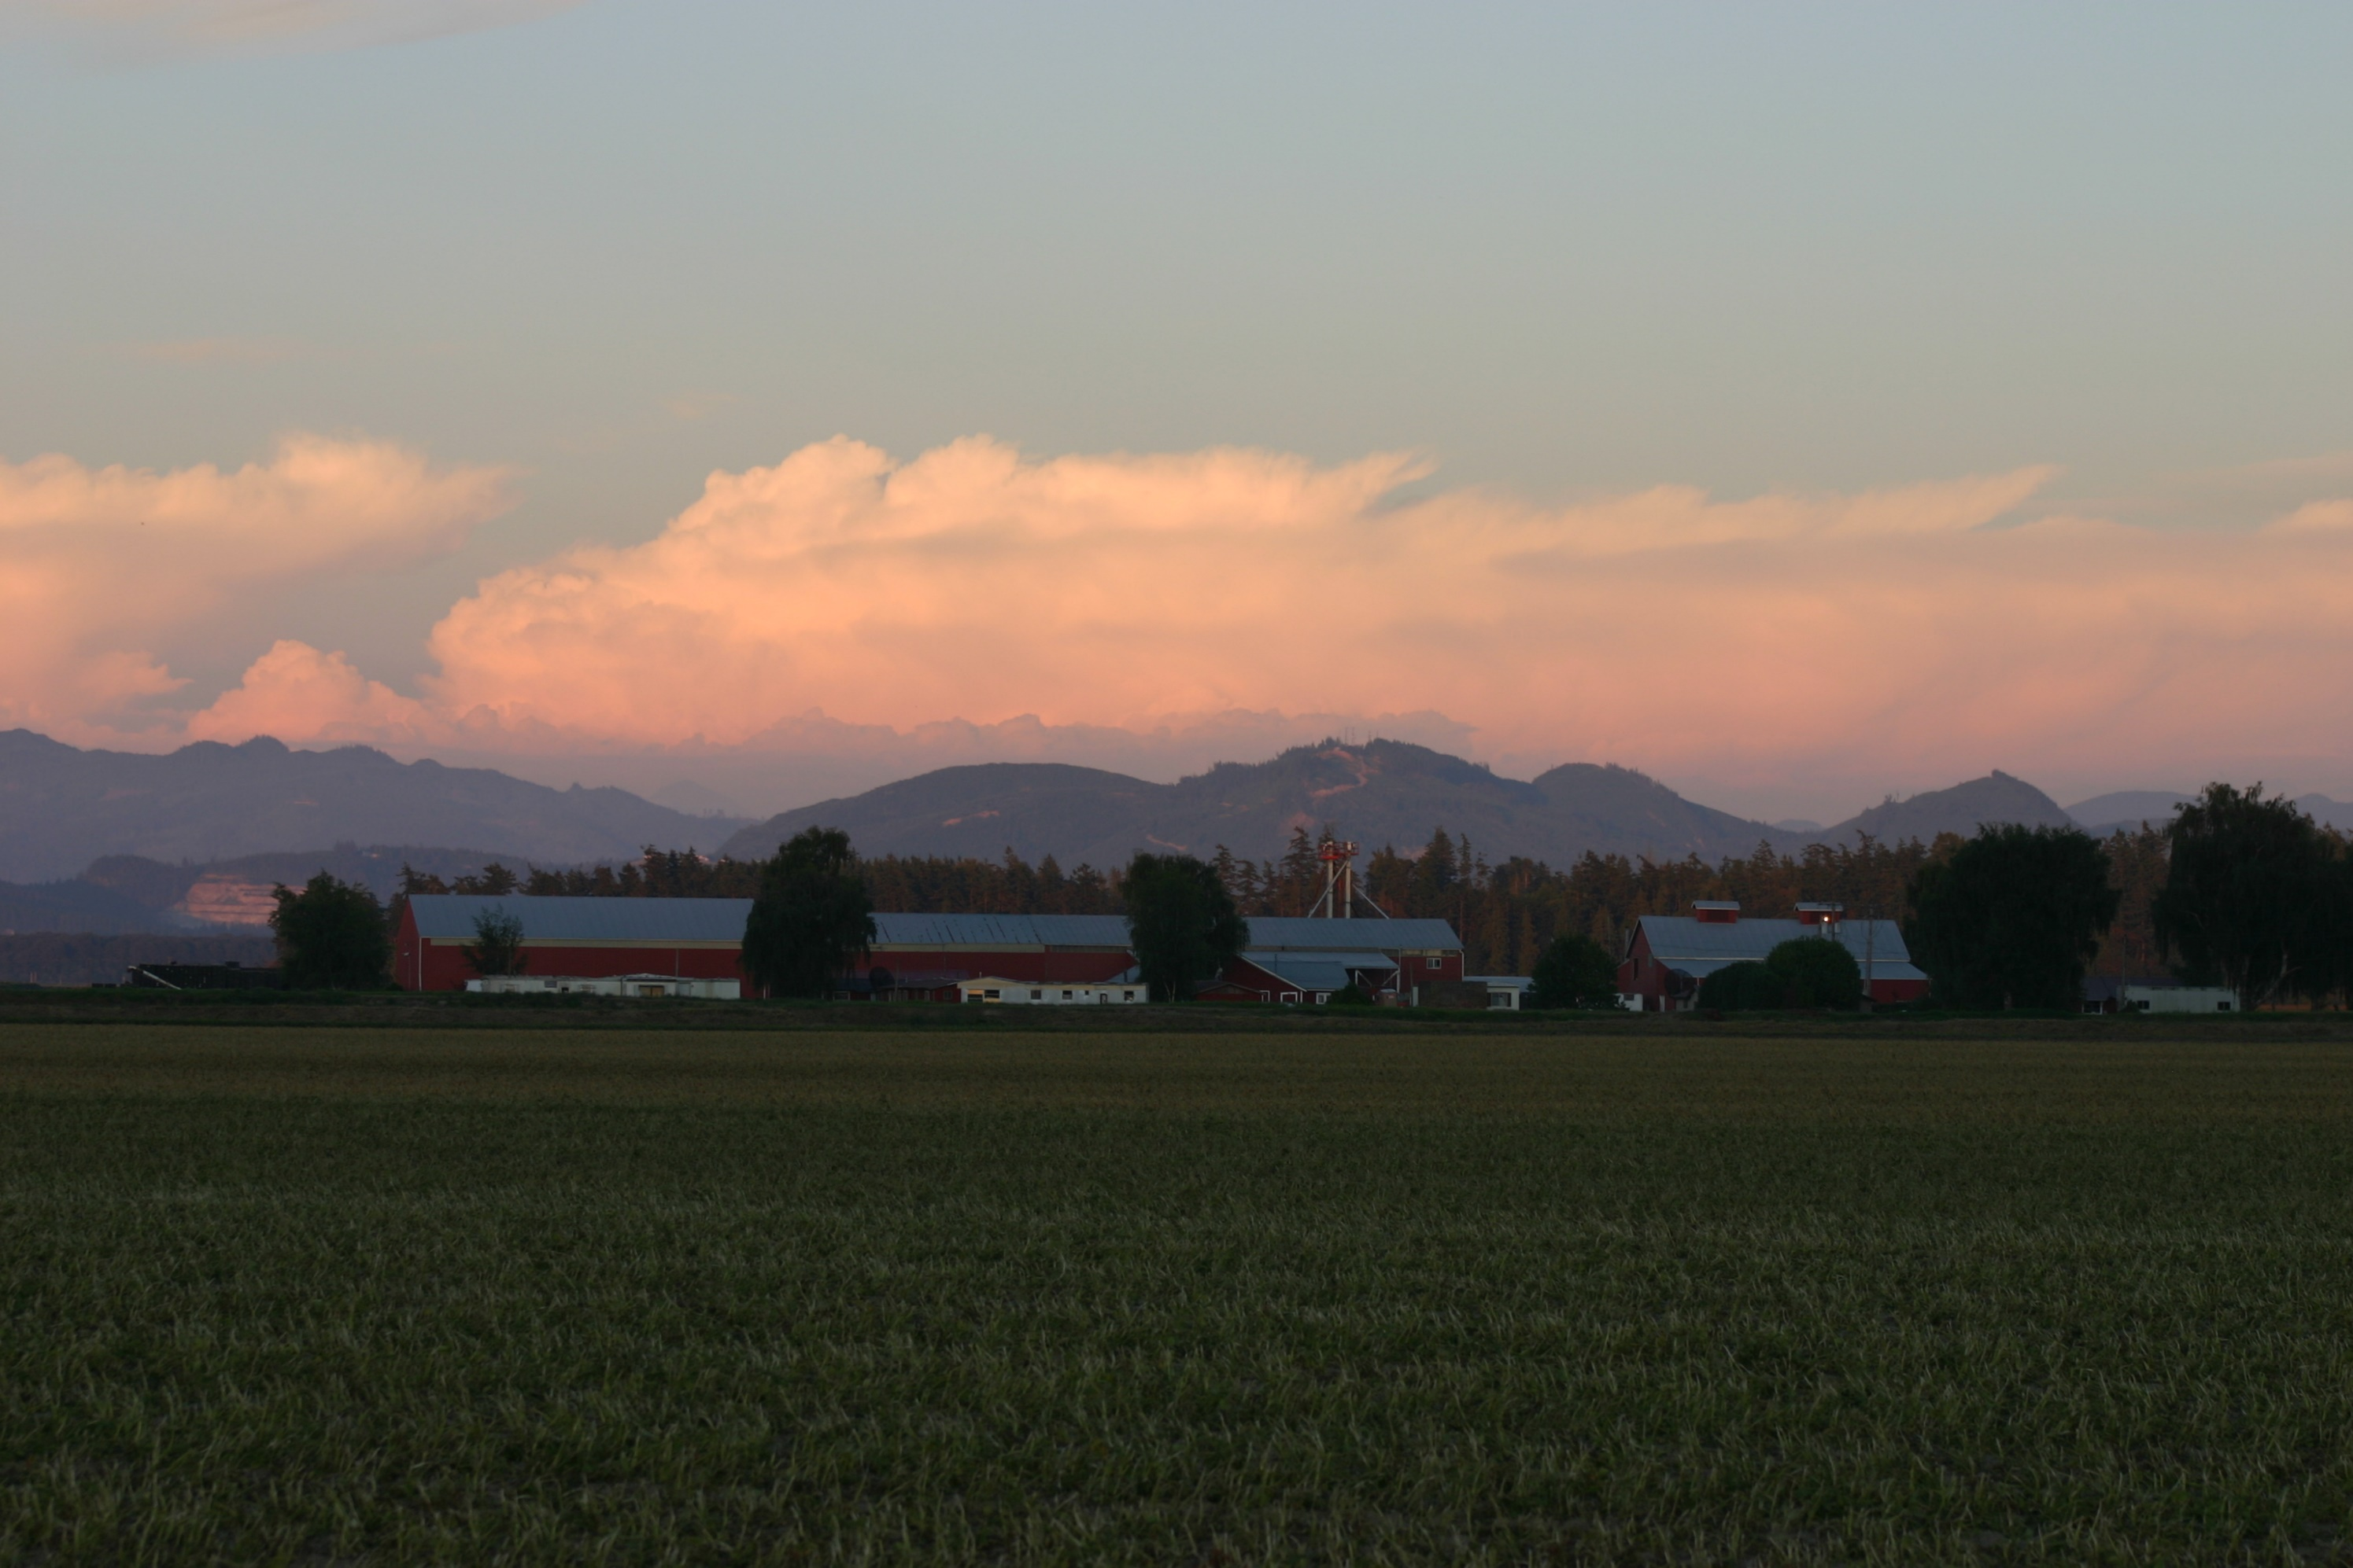

Agritourism
Work Session – Proposed Agritourism Code Amendments
Jack Moore
Planning & Development Services Director
September 16, 2025
Agritourism Website:
https://www.skagitcounty.net/departments/planningandpermit/agtourismmain.htm

Slide 2
Agritourism Background
2023 PDS works through the legislative process with the Planning Commission.
January 2024 BoCC issues a moratorium on the acceptance of permit applications for certain and activities on Ag-NRL Lands.
The BoCC directed the PDS Director to develop a process that will allow landowners to document asserted existing non-conforming use through entry into a Voluntary Compliance Agreement (VCA).
June 2024 BoCC passed a resolution remanding the proposed agritourism code changes to the Skagit County PDS and Planning Commission.
2025 PDS convened a Community Advisory Group to provide recommendations on proposed Agritourism code changes that address remand criteria.
Agritourism Website:
https://www.skagitcounty.net/departments/planningandpermit/agtourismmain.htm

Slide 3
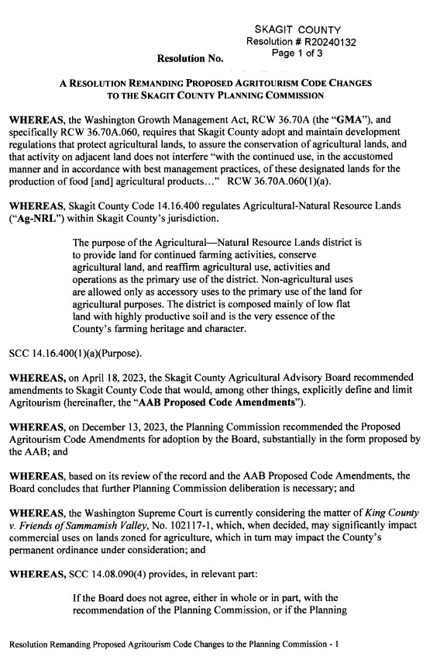
Resolution & Remand Criteria
Resolution #R20240132
Remand Criteria Topics:
Define Agritourism & clarify activity scope
Criteria for Tulip Festival participation
Treatment of East County vs Delta areas
Temporary use/events in Ag-NRL zones
Consistency with WA Supreme Court decision
Agritourism Remand: https://www.skagitcounty.net/Common/Documents/LFDocs/COMMISSIONERS000030/00/00/43/000043d6.pdf

Slide 4
Overview of Agritourism Amendments
Agritourism definition, purpose, and intent.
3 levels of Agritourism based on attendance and frequency of events.
General limitations and performance standards.
Addresses Skagit Valley Tulip Festival.
Prohibits Limited Event Venues, restaurants, and regularly occurring celebratory gatherings (e.g., weddings) in the Agricultural-Natural Resource Lands zone.

Slide 5
Agritourism Definition
Agritourism consists of a range of activities conducted on a working farm or ranch that engages the public for the purpose of agricultural education, enjoyment, or recreation that may generate income for the owner or operator.
Agritourism is separate and distinct from farm-based businesses and agricultural support services.
There are three categories of agritourism: Agritourism 1, Agritourism 2, and Agritourism 3.

Slide 6
Agritourism Purpose & Intent
Agritourism in Skagit County is permitted, as set out in this section, in order to help preserve working farmland, diversify farm income, increase public awareness and appreciation of agriculture, and enhance farm viability.
Skagit County places limitations on agritourism in order to:
Preserve the area’s rural agricultural character.
Prevent the permanent conversion of farmland.
Prevent interference with surrounding farming operations and practices.

Slide 7
Levels of Agritourism
Agritourism Type | Max Number of Guests Allowed | Max Number of Days Allowed
Agritourism 1 (Permitted Use) | 25 | 10
Agritourism 2 (Administrative Special Use) | 100 | 24
Agritourism 3 (Hearing Examiner Special Use) | As Conditioned | As Conditioned
*Between March 15 and May 15, activities that are officially registered with the Skagit Valley Tulip Festival may run for 30-days in addition to the allowed days specified for Agritourism 1, 2, and 3.

Slide 8
General Limitations; Performance Standards
Must be carried out by the owner or operator of working farm or ranch.
Cannot result in conversion of agricultural land.
Cannot degrade rural character.
Cannot interfere with surrounding farming operation.
Artificial lighting and noise generated from Agritourism activities must be consistent with General Performance Standards (SCC 14.20). Studies may be required by the Director.

Slide 9
General Limitations; Performance Standards
Parking cannot use road right-of-way, cannot result in conversion of agricultural land, and must meet parking requirements of SCC 14.26.
Agritourism uses must demonstrate concurrency with the County road segment and road intersection level of service standards.
Access to and from a county road used by the public must be permitted by Public Works, including any conversion of a previously established farm access.
Unforeseen impacts can be mitigated through SEPA review.

Slide 10
Limits on Agritourism 2 or 3
Existing and primary commercial agricultural use has must have generated an average gross income of at least $500 per acre per year over the previous three years.
Must comply with the annual self-certification requirements identified in SCC 14.51.080.
Agritourism 3 use cannot include farm to table activities.
Applicant must sign an agreement, on a form provided by the Director that they will comply with all the requirements of SCC 14.18.407.

Slide 11
Interpretation; Enforcement on Limitations
Skagit County retains the authority to perform ongoing monitoring and evaluation of compliance with established conditions of approval.
Agritourism special use permits can be revoked if applicant fails to meet conditions of the special use permit, including compliance with any requirement set forth in SCC 14.18.407.

Slide 12
Zones Proposed to Allow Agritourism
Agricultural – Natural Resource Lands (Ag-NRL)
Rural Resource – Natural Resource Lands (RRc-NRL)
Rural Reserve (RRv)
Rural Intermediate (RI)

Slide 13
Renaming Temporary Events to Limited Event Venues
“Temporary Use Events” currently allows up to 24 events per year, with permits that do not expire annually or require renewal.
Term “temporary” is misleading.
Proposed name “Limited Event Venues” more accurately reflects the nature and frequency of these activities.
Amendments also clarify that events at permitted uses such as churches, restaurants, grange halls, community centers, and parks are not regulated as Limited Event Venues.

Slide 14
Outdoor Public Musical, Entertainment, Amusement, and Assembly Events (Single Events)
Proposal specifies that Outdoor Public Musical, Entertainment, Amusement, and Assembly Events (Single Events), as defined in SCC 9.08, are permitted in all zones.
Connects Title 14 with SCC 9.08 by explicitly stating that such single events are allowed countywide.

Slide 15
Prohibited Uses in Agricultural – NRL Zone
Proposal would prohibit the following in the Agricultural – Natural Resource Lands zone:
Limited Event Venues
Restaurants
Regularly occurring celebratory gatherings (e.g., weddings)

Slide 16
Next Steps
Public Comment Period September 25th – October 16th
October 14th Planning Commission Public Hearing
November 18th Planning Commission Deliberations
November 24th Board of County Commissioners Work Session
December 23rd Possible Adoption by Board of County Commissioners

Slide 17
Questions?
Agritourism Website:
https://www.skagitcounty.net/departments/planningandpermit/agtourismmain.htm

